Slide 1
Stack
Array and Linked List based

Slide 2
What is a Stack?
Stack is a linear data structure in which the insertion and deletion operations are performed at only one end.
In a stack, adding and removing of elements are performed at a single position which is known as "top". That means, a new element is added at top of the stack and an element is removed from the top of the stack.
In stack, the insertion and deletion operations are performed based on LIFO (Last In First Out) principle.

Slide 3
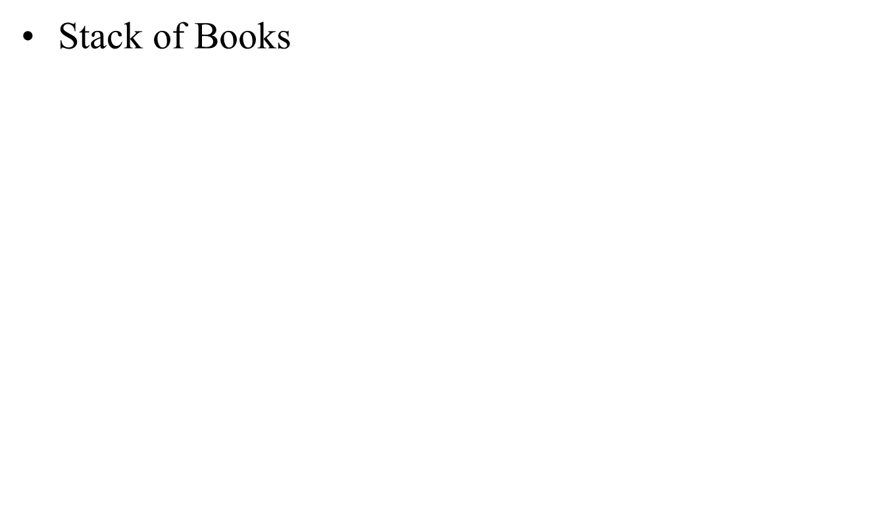


Slide 4
Stacks
What is a Stack?
A stack is a data structure of ordered items such that items can be inserted and removed only at one end.

Slide 5
Stacks
What can we do with a stack?
push - place an item on the stack
pop - Look at the item on top of the stack and remove it

Slide 6
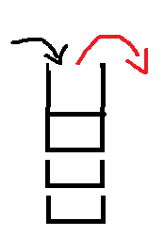
Stack
A stack is a data structure that stores data in such a way that the last piece of data stored, is the first one retrieved
also called last-in, first-out ( LIFO )
Only access to the stack is the top element

Slide 7
Stack
Primary operations: Push and Pop
Push
the operation to place a new item at the top of the stack
Pop
the operation to remove the next item from the top of the stack

Slide 8
Push and Pop
Push
Add an element to the top of the stack
Pop
Remove the element at the top of the stack
empty stack
push an element
push another
pop
top
B
top
top
top
A
A
A

Slide 9
Stack
M
C
C
C
R
push(M)
R
item = pop()
item = M
R
X
X
X
A
A
A

Slide 10
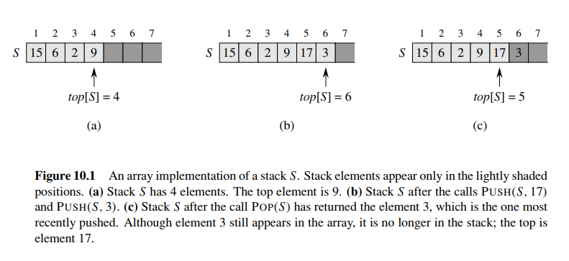

Slide 11
Stacks
Problem:
What happens if we try to pop an item off the stack when the stack is empty?
This is called a stack underflow. The pop method needs some way of telling us that this has happened.

Slide 12
Implementing a Stack
At least three different ways to implement a stack
array
vector
linked list
Which method to use depends on the application
what advantages and disadvantages does each implementation have?

Slide 13
Implementing Stacks: Array
Advantages
best performance
Disadvantage
fixed size
Basic implementation
initially empty array
field to record where the next data gets placed into
if array is full, push() returns false
otherwise adds it into the correct spot
if array is empty, pop() returns null
otherwise removes the next(top) item in the stack

Slide 14
Stack Class (array based)
Variable top;
Variable MAX;
variable stack[MAX];
top=-1;
max=4;
full()
empty()
push(int value)
pop()
display()

Slide 15
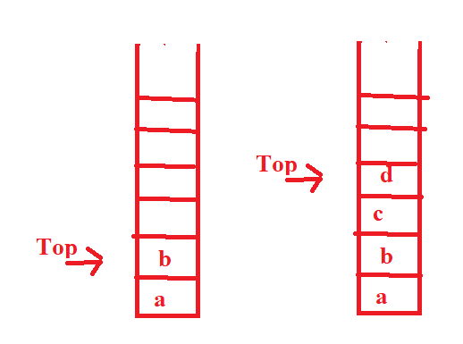
push() Method (array based)
void push(int value)
{
top++;
a[top]= value;
}

Slide 16
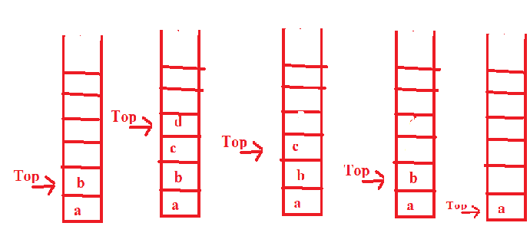
pop() Method (array based)
char pop()
{
char temp;
temp=a[top];
top--;
return temp;
}

Slide 17
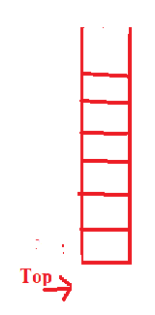
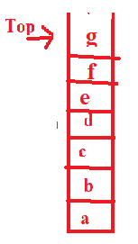
Remaining Methods (array based)
bool full(){
if (top==max)
return true;
else
return false;
}
bool empty(){
if (top==-1)
return true;
else
return false;
}

Slide 18
Remaining Methods (array based)
void display()
{
if (top==-1)
cout<<"\n No elements in stack \n";
else
{
cout<<"The elements in stack are:";
for (int i=top;i>=0;i--)
cout<<"\n"<<a[i];
}
}

Slide 19
Array implementation - Algorithm
begin procedure push: stack, data
if stack isfull
return null
endif
top ← top + 1
stack[top] ← data
end procedure
begin procedure pop: stack
if stack isempty
return null
endif
data ← stack[top]
top ← top - 1
return data
end procedure
begin procedure isfull
if top equals to MAXSIZE
return true
else
return false
endif
end procedure
begin procedure isempty
if top less than 0
return true
else
return false
endif
end procedure

Slide 20
#include<stdio.h>
#include<conio.h>
#define SIZE 10
void push(int);
void pop();
void display();
int stack[SIZE], top = -1;
void main()
{
int value, choice;
clrscr();
while(1){
printf("\n\n***** MENU *****\n");
printf("1. Push\n2. Pop\n3. Display\n4. Exit");
printf("\nEnter your choice: ");
scanf("%d",&choice);
switch(choice){
case 1: printf("Enter the value to be insert: ");
scanf("%d",&value);
push(value);
break;
case 2: pop();
break;
case 3: display();
break;
case 4: exit(0);
default: printf("\nWrong selection!!! Try again!!!");
}
}
}
}
}
}

Slide 21
void pop(){
if(top == -1)
printf("\nStack is Empty!!! Deletion is not possible!!!");
else{
printf("\nDeleted : %d", stack[top]);
top--;
}
}
void display(){
if(top == -1)
printf("\nStack is Empty!!!");
else{
int i;
printf("\nStack elements are:\n");
for(i=top; i>=0; i--)
printf("%d\n",stack[i]);
void push(int value){
if(top == SIZE-1)
printf("\nStack is Full!!! Insertion is not possible!!!");
else{
top++;
stack[top] = value;
printf("\nInsertion success!!!");
}

Slide 22
Implementing Stack Using Linked List

Slide 23
Implementing a Stack: Linked List
Advantages:
always constant time to push or pop an element
can grow to an infinite size
Disadvantages
the common case is the slowest of all the implementations
can grow to an infinite size
Basic implementation
list is initially empty
push() method adds a new item to the head of the list
pop() method removes the head of the list

Slide 24
Stack Class (list based)
struct NodeType {
ItemType info;
NodeType* next;
};
struct stack{
int data;
stack *link;
}*top;

Slide 25
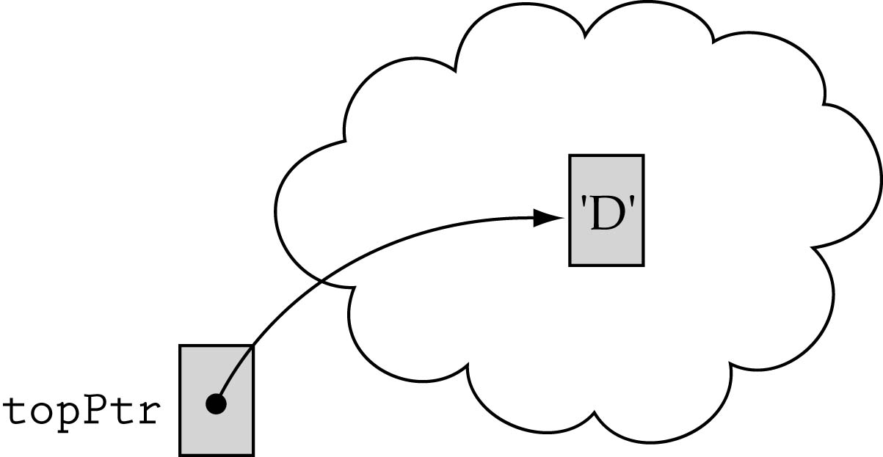
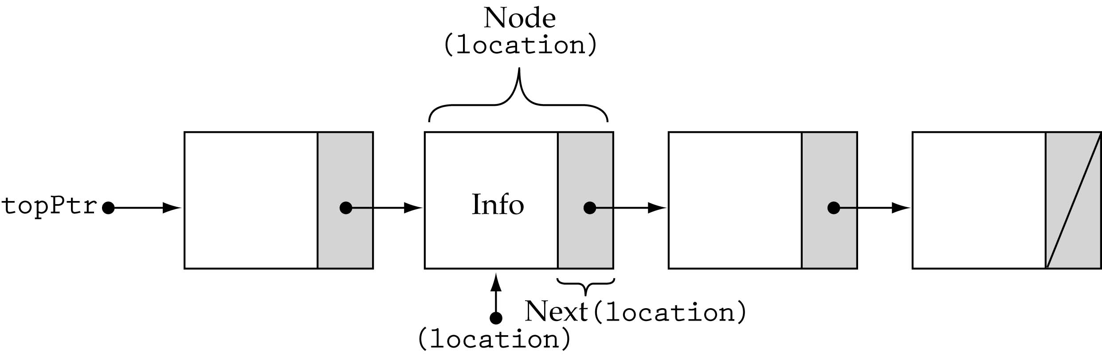
First and last stack elements
We need a data member to store the pointer to the top of the stack
The next element of the last node should contain the value NULL

Slide 26
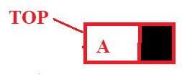
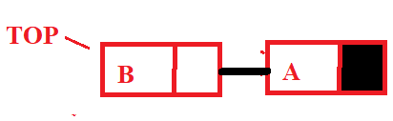
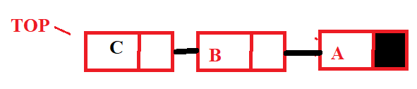
struct stacknode{
int data;
stacknode *next;
}*top;

Slide 27
Push(data)
push(int n)
{
NodeType<ItemType>* location;
location = new NodeType<ItemType>;
location->info = newItem;
location->next = topPtr;
topPtr = location;
}

Slide 28
Push(data)
push(int n)
{
stack *q;
q=new stack;
q->link=top;
q->data=n;
top=q;
}

Slide 29
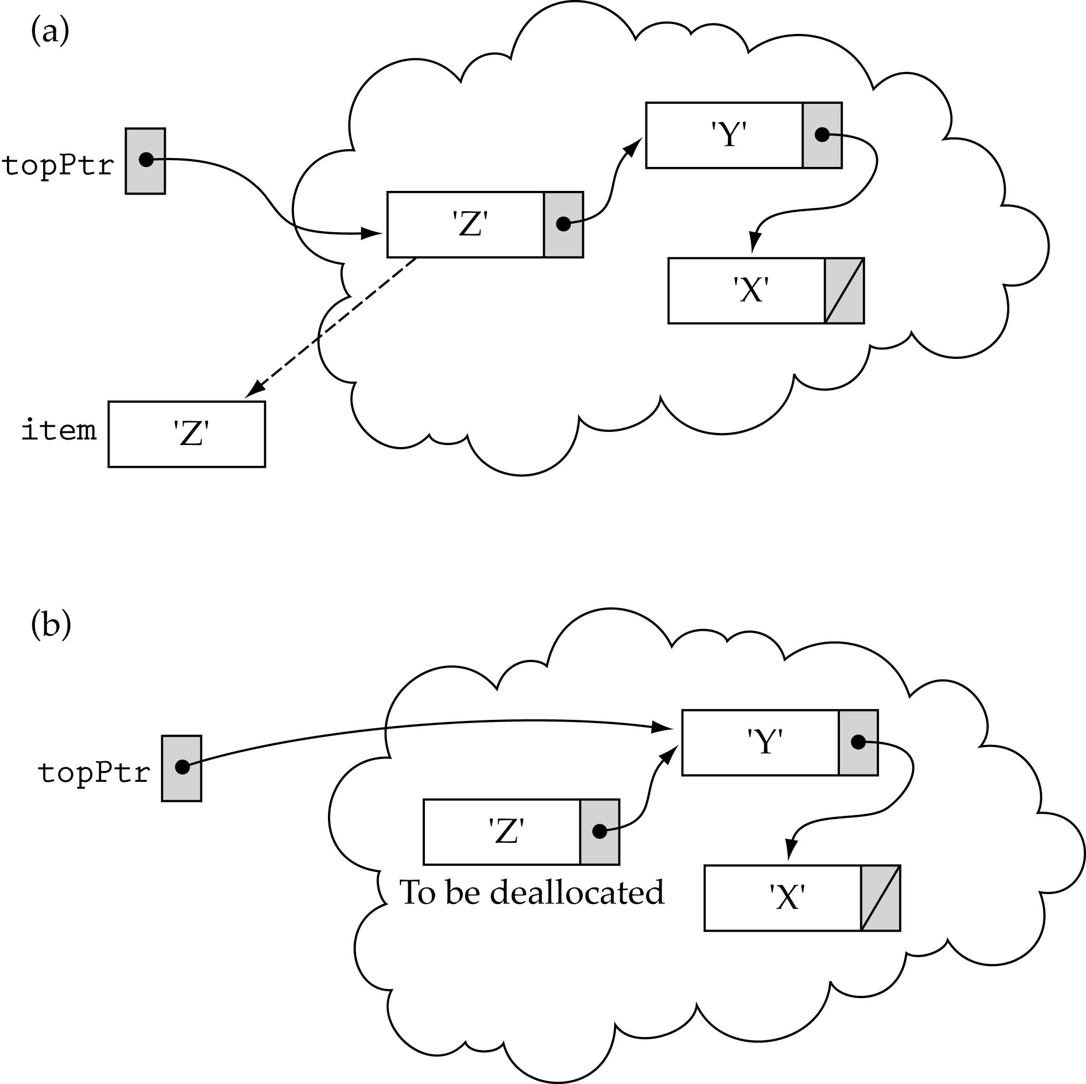
Popping the top element

Slide 30
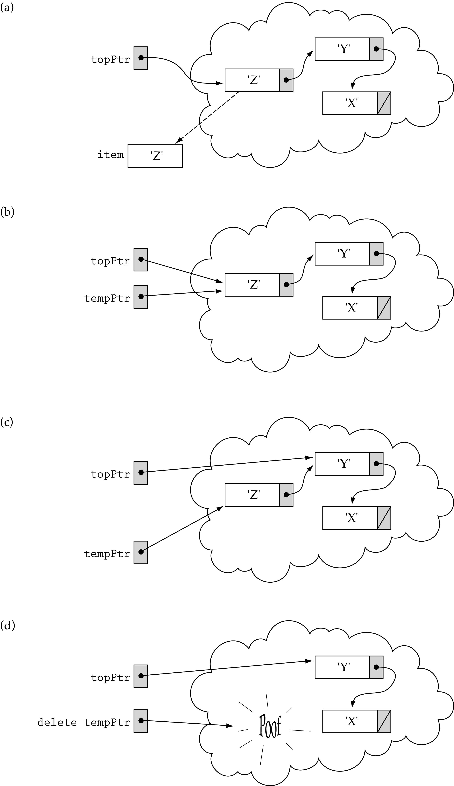
Popping the top element (cont.)
Need to use a temporary pointer

Slide 31
Pop()
pop()
{
item = topPtr->info;
tempPtr = topPtr;
topPtr = topPtr->next;
delete tempPtr;
}

Slide 32
pop()
{
item = topPtr->info;
tempPtr = topPtr;
topPtr = topPtr->next;
delete tempPtr;
}

Slide 33
#include<stdio.h>
#include<conio.h>
struct Node
{
int data;
struct Node *next;
}*top = NULL;
void push(int);
void pop();
void display();
void main()
{
int choice, value;
clrscr();
printf("\n:: Stack using Linked List ::\n");
while(1){
printf("\n****** MENU ******\n");
printf("1. Push\n2. Pop\n3. Display\n4. Exit\n");
printf("Enter your choice: ");
scanf("%d",&choice);
switch(choice){
case 1: printf("Enter the value to be insert: ");
scanf("%d", &value);
push(value);
break;
case 2: pop(); break;
case 3: display(); break;
case 4: exit(0);
default: printf("\nWrong selection!!! Please try again!!!\n");
}
}
}

Slide 34
void push(int value)
{
struct Node *newNode;
newNode = (struct Node*)malloc(sizeof(struct Node));
newNode->data = value;
if(top == NULL)
newNode->next = NULL;
else
newNode->next = top;
top = newNode;
printf("\nInsertion is Success!!!\n");
}
void pop()
{
if(top == NULL)
printf("\nStack is Empty!!!\n");
else{
struct Node *temp = top;
printf("\nDeleted element: %d", temp->data);
top = temp->next;
free(temp);
}
}
void display()
{
if(top == NULL)
printf("\nStack is Empty!!!\n");
else{
struct Node *temp = top;
while(temp->next != NULL){
printf("%d--->",temp->data);
temp = temp -> next;
}
printf("%d--->NULL",temp->data);
}
}

Slide 35
Reverse Polish Notation
Way of inputting numbers to a calculator
(5 + 3) * 6 becomes 5 3 + 6 *
5 + 3 * 6 becomes 5 3 6 * +
We can use a stack to implement this
consider 5 3 + 6 *
+
6
*
3
6
5
8
8
48
try doing 5 3 6 * +

Slide 36
Stack Applications
Stacks are a very common data structure
compilers
parsing data between delimiters (brackets)
operating systems (Memory Management)
program stack
virtual machines
manipulating numbers( Expression Evaluation)
pop 2 numbers off stack, do work (such as add)
push result back on stack and repeat
artificial intelligence
Back Tracking( Game playing,finding a path, exhaustive search )

